Slide 1


Industrial Employee Safety and Occupational Health Management System
DSA0101–OOPSwithC++ | SlotD | CapstoneProject–Review2 | Team8
Team 8
Deepika S — 1921260057 Dharshidha S — 1911260095 Monisha S — 1921260015
Supervisor
Dr. K. Parimala Kanaga Devan Professor, SIMATS Engineering

Slide 2
Abstract
•
Industrial workplaces such as factories, warehouses, and construction sites face constant risks of accidents, injuries, and health hazards from unsafe conditions, hazardous gases, and machinery.
Manual safety inspection and paper-based incident reporting are slow, error-prone, and reactive rather than preventive.
This project proposes an Industrial Employee Safety and Occupational Health Management System that digitizes safety compliance, tracks employee health records, monitors hazard zones, and automates incident reporting and alerts.
The system is built using Object-Oriented Programming concepts in C++ to model employees, safety equipment, hazard zones, and incident records as reusable, maintainable classes.
The goal is to reduce workplace accidents, ensure regulatory compliance, and improve response time during emergencies.
•
•
•
•
3

Slide 3
Existing System
•
Safety inspections and incident reports are largely manual and paper-based, causing delays in identifying hazards.
No centralized system tracks employee health history, PPE compliance, and training records together. Hazardous zones (gas leaks, high temperature, restricted machinery areas) are not monitored in real time. Emergency alerts depend on manual reporting, increasing response time during accidents.
Existing IoT-based solutions from literature focus mainly on sensor hardware and lack an integrated, extensible software backend.
There is a lack of role-based access for supervisors, safety officers, and employees within a single management system.
• • • •
•
4

Slide 4
Problem Statement
Manual, paper-based safety inspection and incident reporting delay hazard detection and corrective action. Employee health, PPE compliance, and training records are fragmented across different registers, making them hard to track together.
Hazardous zones are not monitored continuously, so unsafe conditions can go unnoticed until an accident occurs. Emergency response is slow because alerts rely on someone manually noticing and reporting a hazard.
There is no unified, software-driven system to manage employees, hazard zones, incidents, and compliance under one platform.
5

Slide 5
Objectives
• • • • • • • •
Develop an Industrial Employee Safety and Occupational Health Management System using C++.
Apply Object-Oriented Programming concepts to model employees, hazard zones, and incidents as reusable classes. Store and manage employee profiles, health records, and training/certification status.
Classify hazard zones by risk level and log sensor-based hazard events.
Digitize incident and near-miss reporting with severity classification and corrective action tracking.
Track PPE issuance and compliance status for every employee.
Generate real-time alerts and notifications to supervisors during hazard or incident events.
Improve workplace safety, regulatory compliance, and emergency response time.
6

Slide 6

Literature Survey (Latest Papers)
Year
Title / Authors
Key Contribution
2024–25
Smart IoT System for Real-Time Worker Safety Monitoring in Dead Zones (IEEE, 2025)
Wearable sensors with ML-based fall detection and location tracking in connectivity-limited zones.
2024–25
Comprehensive IoT-Based Monitoring System for Worker's Health and Safety in High-Risk Environments (IEEE, 2024)
Real-time SpO2, heart rate, gas and temperature monitoring with dashboard alerts.
2023–24
Shah, I.A. & Mishra, S. — AI in Advancing Occupational Health and Safety (2024)
Reviews how AI/ML predicts and prevents workplace hazards, improving OHS decisions.
2023–24
IoT-Enhanced Workplace Safety for Real-Time Monitoring and Hazard Detection (IEEE, 2024)
Sensor network architecture for environmental and wearable monitoring with hazard analytics.
2022–23
IoT Based Wearable Device for Workers in Industrial Scenarios (IEEE, 2023)
ESP-32 based wearable tracking gas exposure, pulse rate, body temperature and emergency alerts.
2022–23
IoT based Smart Bracelet for Worker Safety and Health Monitoring (IWAIIP, IEEE, 2023)
Accelerometer-based vibration monitoring for machine operators with mobile/web notifications.
7

Slide 7



Proposed System / Solution
Employee& Health Management Module
HazardZone & Alert Module
Incident & Compliance Module
Stores employee profiles, health records, and training/certification status, using OOP principles such as classes, inheritance, and encapsulation.
Models zones with risk levels, links sensor data to affected employees, and automatically raises real-time alerts when thresholds are breached.
Digitizes incident / near-miss reporting with severity classification and tracks PPE issuance and compliance status per employee.
8

Slide 8

System Modules
Employee Management Module
Health & Medical Records Module
Add,update,and view employee details,department, and role.
Maintains periodic health checkup data and flags at-risk employees.
Hazard Zone Monitoring Module
Incident & Accident Reporting Module
Classifies zones by risk level and logs sensor-based hazard events.
Records incidents with cause,severity,and corrective action taken.
PPE & Compliance Tracking Module
Alert & Notification Module
Tracks safety equipment issued and compliance verification.
Sends real-time alerts to supervisors during hazard or incident
events.
9

Slide 9

Module 1: Employee & Health Management
OOP Concepts Used
Functions
Output
• • • •
Classes and Objects Encapsulation Constructors Inheritance
• •
Add new employee records Update employee & department details
Store periodic health checkup data Flag at-risk employees
Track training / certification status Search employee by ID or name
• • •
Updated employee database Accurate health & training records List of at-risk employees
• • • •
10

Slide 10

Module 2: Hazard Zone Monitoring & Alerts
OOP Concepts Used
Functions
Output
• • •
Inheritance Polymorphism Virtual Functions
• •
Classify zones by risk level
Log sensor-based hazard events (gas, temperature)
Link hazard data to affected employees
Auto-raise alert when threshold is breached
Notify supervisors in real time
• • •
Real-time hazard alerts Zone risk classification log Faster emergency response
•
•
•
11

Slide 11

Module 3: Incident, PPE & Compliance
OOP Concepts Used
Functions
Output
• • •
Encapsulation File Handling Abstraction
•
Record incidents with cause & severity
Log corrective action taken
Track PPE issuance per employee Verify PPE compliance status Generate compliance & incident reports
• • •
Digitized incident records PPE compliance report Regulatory audit trail
• • • •
12

Slide 12
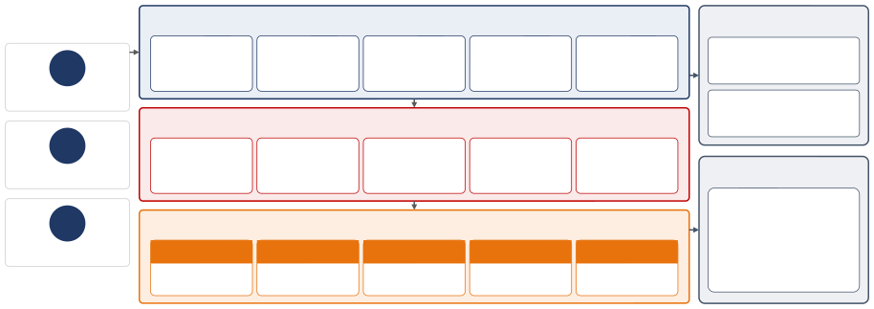
System Architecture
Users
(Presentation Layer)
UserInterface—Console/Menu-Driven (C++)
External Components
Login & Registration
Employee Dashboard
Hazard Zone Monitor
Incident & PPE Desk
Reports & Alerts
Alert Notification Service (SMS /
Email)
EM
Employee
Printer — Compliance & Incident
Application Layer — C++ OOP Classes
Reports
SO
Safety Officer
Hazard Zone Management
Employee Management
Incident Management
PPE Management
Alerts & Reports
File Storage
Data Layer — File-Based Storage (.dat)
SU
Supervisor
Employee records, incident logs, PPE &
EMPLOYEES
HAZ ARD _Z ON ES
INCIDENTS
PPE_RECORDS
TR AININ G
training data, and backup (.dat) files
Data Flow External Link
emp_id, name, role
zone_id, risk_level
incident_id, severity
emp_id, item, status
emp_id, cert, expiry
Security Layer — Authentication • Authorization • Role-Based Access Control (Employee / Safety Officer / Supervisor)
13

Slide 13
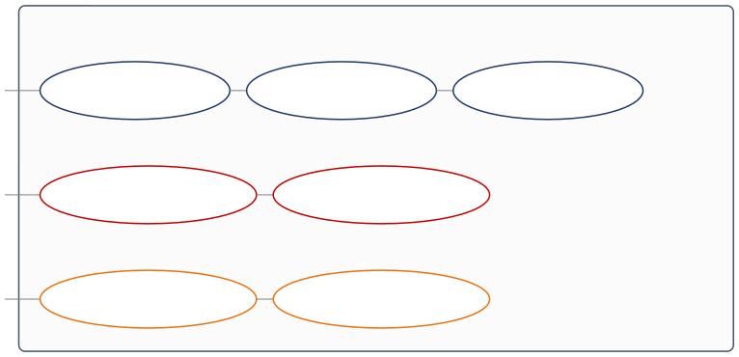



Use Case Diagram
Industrial Employee Safety & Occupational Health Management System
Monitor Hazard Zones
Log Incidents
Manage PPE Compliance
Safety Officer
View Alerts & Reports
Approve Corrective Action
Supervisor
View Health Records
Report Near-Miss
Employee
14

Slide 14

System Workflow
Employee / Sensor Input
Data Validation & Classification
Risk / Severity Evaluation
Alert & Notification
Record &
Report Generation
Continuous loop: hazard zones and PPE compliance are re-checked after every logged event.
15

Slide 15

Tools and Technologies
Software
Technologies Used
OOP Concepts
• • •
Code::Blocks / Dev-C++ GCC Compiler
Windows Operating System
• • •
C++ Programming Language Object-Oriented Design
File Handling for persistence
• • • • •
Classes & Objects Encapsulation Inheritance Polymorphism Abstraction
16

Slide 16
OOP Concepts Used
• • • • • • •
Classes and Objects – represent employees, hazard zones, incidents, and PPE items as system entities. Encapsulation – combines employee, health, and compliance data with the functions that operate on them. Inheritance – supports reusable class structures across employee roles and hazard-zone types. Polymorphism – provides different alert / reporting behaviours through function overriding.
Abstraction – represents essential safety operations while hiding internal implementation detail. Constructors – used to initialize employee, zone, and incident objects with default/starting data.
File Handling – used for storing and retrieving employee, incident, and compliance records.
17

Slide 17
Advantages
• • • • • • •
Replaces manual, paper-based safety processes with a unified digital system. Provides real-time hazard-zone monitoring and faster emergency alerts. Centralizes employee health, PPE compliance, and training records in one place. Reduces human error in incident reporting and safety documentation.
Improves regulatory compliance and audit readiness.
Modular OOP-based design makes the system easy to maintain and extend. Supports faster, more informed decision-making by supervisors and safety officers.
18

Slide 18
Future Scope
• • • • • •
Integration with real-time IoT sensors for gas, temperature, and wearable health monitoring. Machine learning-based predictive analytics to anticipate hazards before they occur.
Mobile application for supervisors and employees to receive alerts remotely.
Cloud-based storage for centralized, multi-site safety data management.
Dashboard-based visual analytics for hazard trends and compliance tracking.
GPS / location-based tracking of employees in large industrial sites.
19

Slide 19
Conclusion
•
The proposed Industrial Employee Safety and Occupational Health Management System replaces manual, fragmented safety processes with a unified, object-oriented software solution.
By integrating employee records, hazard monitoring, incident reporting, and PPE compliance into one system, organizations can respond faster to emergencies and reduce workplace accidents.
The modular OOP-based design allows the system to be extended in future with IoT sensor integration and predictive analytics for proactive hazard prevention.
Overall, the system contributes to a safer, more compliant, and more accountable industrial workplace.
•
•
•
20

Slide 20
References
[1] R. Raman and A. Mitra, "IoT-Enhanced Workplace Safety for Real-Time Monitoring and Hazard Detection for Occupational Health," Proc. Int.
Conf. AIfor Innovations in Healthcare Industries (ICAIIHI), 2023.
[2] T. Montanaro, I. Sergi, I. Stefanizzi, L. Landi, L. Di Donato, and L. Patrono, "IoT-Aware Architecture to Guarantee Safety of Maintenance Operators in Industrial Plants," Applied System Innovation, vol. 6, no. 2, Art. 46, 2023.
[3] Y. Hong and J. Cho, "Enhancing Individual Worker Risk Awareness: A Location-Based Safety Check System for Real-Time Hazard Warnings in Work-Zones," Buildings, vol. 14, no. 1, Art. 90, 2024.
[4] M. F. Ahmed, M. R. A. Khan, and M. N. Islam, "Wearable and IoT-Integrated Solutions for Electrical Hazard Prevention in Industrial Environments," JAIGS, vol. 8, no. 1, pp. 136–149, 2025.
[5] S. Pradeep Kumar, G. R. Kanagachidambaresan, and A. Amalin Prince, "Industrial Safety Detecting Deviations and Monitoring Using IIoT 4.0," Proc. 5th Int. Conf. Frontiers in Computing and Systems (COMSYS 2024), LNNS, vol. 1488, Springer, pp. 161–175, 2026.
21

Slide 21

THANK YOU
Industrial EmployeeSafetyandOccupationalHealthManagementSystem — Team 8

